Slide 1
GRAPHQL
Scott Plummer Ft. Kerry Gip
Notes:
I will be going over the summer project that I was working on with Scott

Slide 2
What is it?
GraphQL is a query language that focuses on retrieving data elements
Allows users to only consume the data that they need
It makes it easier to aggregate data from multiple sources
Can handle data from multisource content
REST is used to give web services a structure.
Allows over and under fetching.
This causes performance issues and architecture complexity which results in high maintenance and cost of the platform

Slide 3
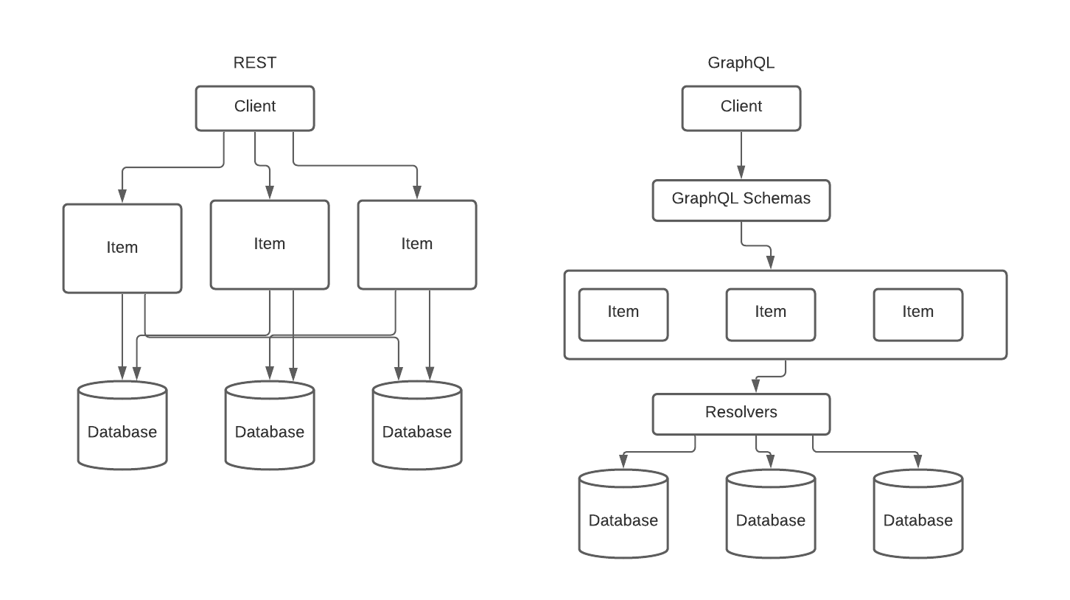
REST VS GraphQL
User sends out a query
Query is written and connected to a schema
Schema types are then organized in the Federation
Resolvers go and grab the information that was queried from multiple databases in one call
Apollo GraphQL Federation

Slide 4
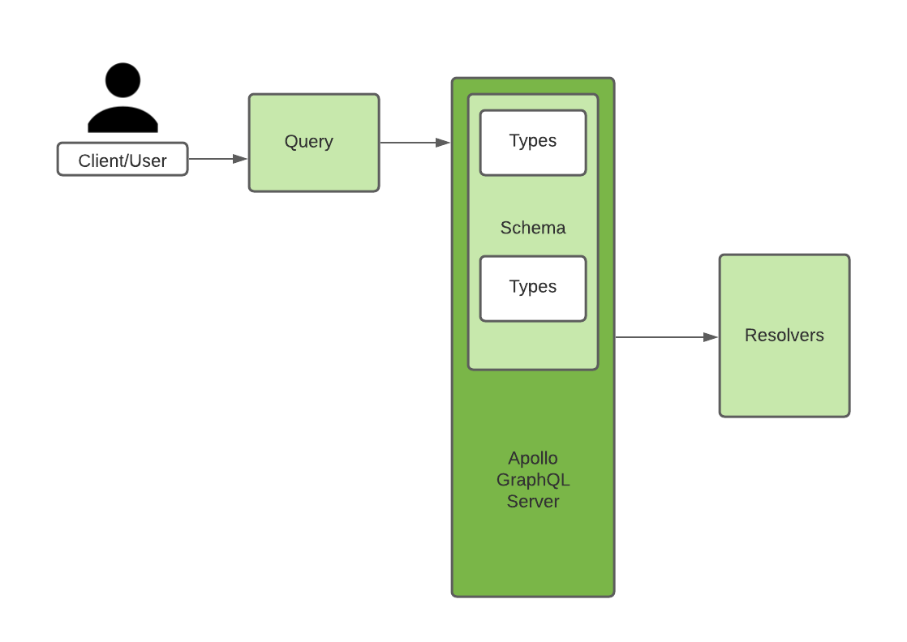
How it works
Setup an Ubuntu Virtual Machine in Azure and loaded up the Apollo GraphQL server that leverages the MongoDB interface to CosmosDB
Query – client specific data that is needed.
Type – Characterize data and what should be fetched
Schema – Collection of types
Defines how a client can access data from the server
Resolvers - Collects the data that is requested
GraphiQL – Built in documentation
Notes:
Q.Q Transparency
GraphQL comprises of different components that help make it work
Type system

Slide 5
SAmple Code
Sample TypeDef
Sample Schema
type Hotel {
name: String
location: Location
phone: String
listOfSupplierSpecificData: [Supplier]
}
type Location {
type: String
coordinates: [String]
}
This is a collection of data
const hotelsSchema = new mongoose.Schema ({
name: { type: String},
phone: { type: String},
location: {
type: pointSchema
},
listOfSupplierSpecificData: [SupplierDataSchema]
});
This is what gets sent to the resolver and defines what sort of information that needs to get pulled and how.
Hotel data is pulled using Mongo

Slide 6
Apollo GraphQL Server
Apollo is an open-sourced environment that allows you to write GraphQL Schemas with all the different types and fields in your queries
Can be deployed to any hosted or serverless environment
Apollo Client's cache improves performance by preventing unnecessary network requests.
Notes:
The cache is saved locally in the @apollo/client library
Apollo can be backed with the Redis or memcached caches

Slide 7
Apollo Federation
Apollo Federation is how we implement GraphQL in a microservice architecture.
Solves pain points such as:
Connecting microservices with a single call
Aggregates different databases and different CHuD datasets
Flexible interface
Changes are less prone to break code and would not need versioning
Let’s you work incrementally
Allows for scalability

Slide 8
Benefits
Increases speed
Improves efficiency
Improve deployment
Improve customer satisfaction
Simplifies current architecture
Allows us to consume only the data that we need
Prevents under/over fetching
Doesn’t encounter API call limits since its uses fewer queries

Slide 9
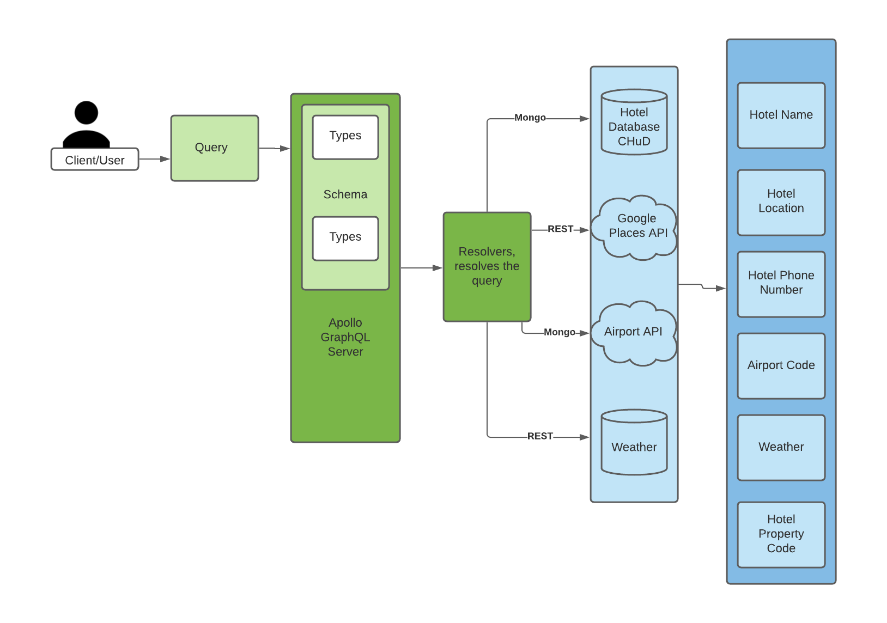
Notes:
Next Steps
Replace CHuD Query App
Or can make a complimentary GraphQL API

